Slide 1
Easy To Build Demonstrations
Solar Penny Melter and
Rubens Tube
Ann Hammersly - Chaparral H.S.
Tom Vining - Desert Mountain H.S.
Ryan Hill - Desert Mountain H.S.

Slide 2
Rubens Tube
Materials and supplies
Several 1/16” drill bits
2 - Stove pipe 4” x 48”
1 – 4” end cap
1 - Hose barb 3/8” x 1/4”
1 – Reducer 1/4” x 1/8”
2 – Metal washers
2 - Rubber washers
Metal duct tape

Slide 3
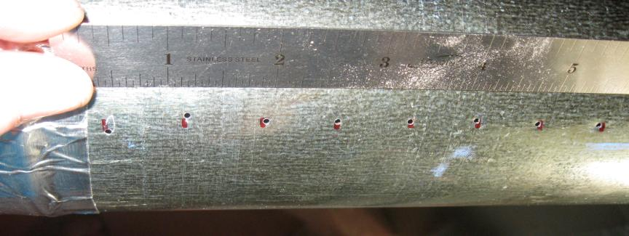
Pre punch holes every 3/4”. Drill holes with a 1/16” diameter bit (a drill press is very helpful)

Slide 4
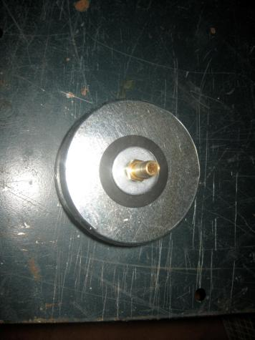
End cap

Slide 5
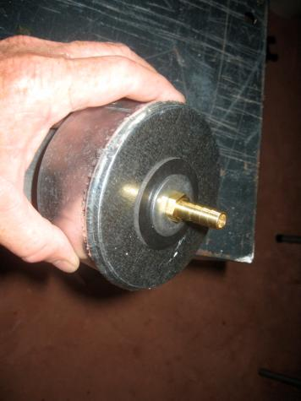
3/8” x 1/4” hose barb, metal and rubber washer

Slide 6
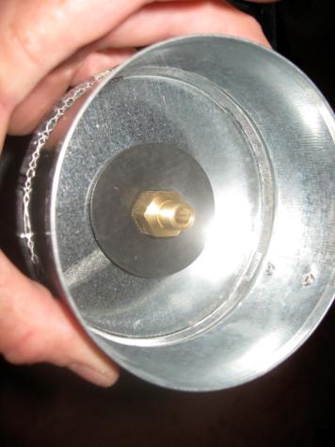
1/4” x 1/8” reducer and rubber washer

Slide 7
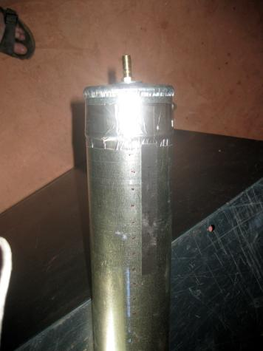
Tape end cap on

Slide 8
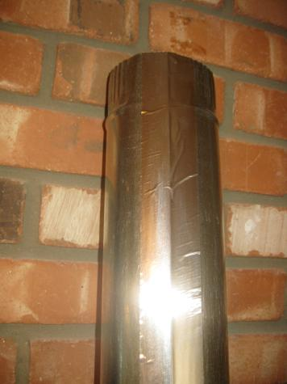
Taping the seam

Slide 9
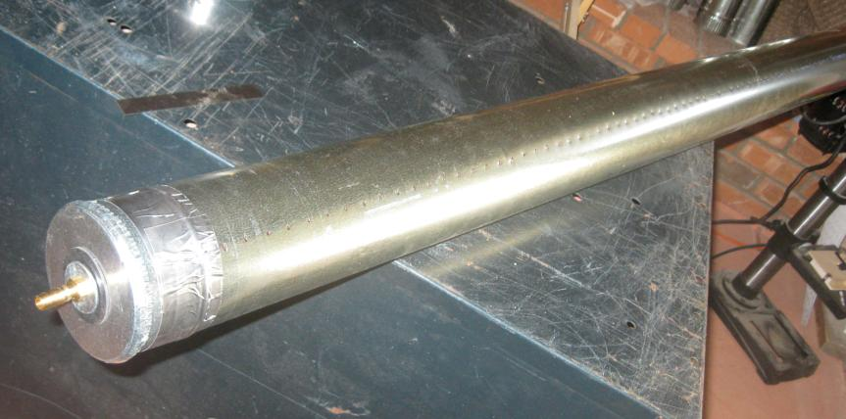
Lots and lots of 1/16” holes - ¾” apart

Slide 10
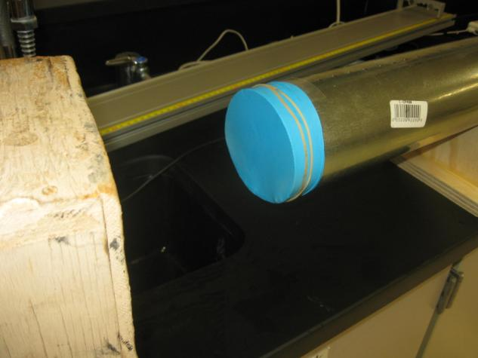
Cover other end with balloon

Slide 11
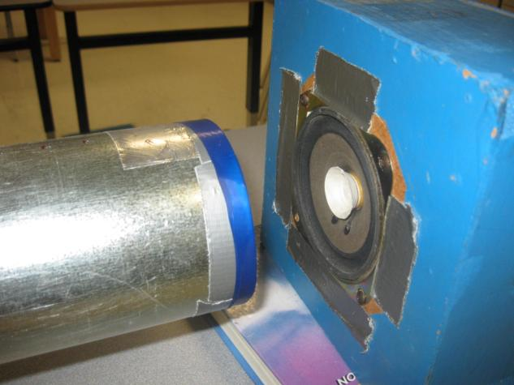
Old car stereo speaker

Slide 12
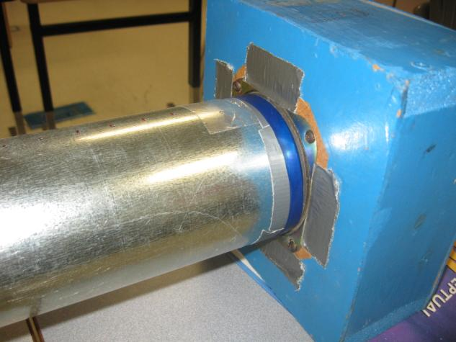
Balloon end up against the speaker

Slide 13
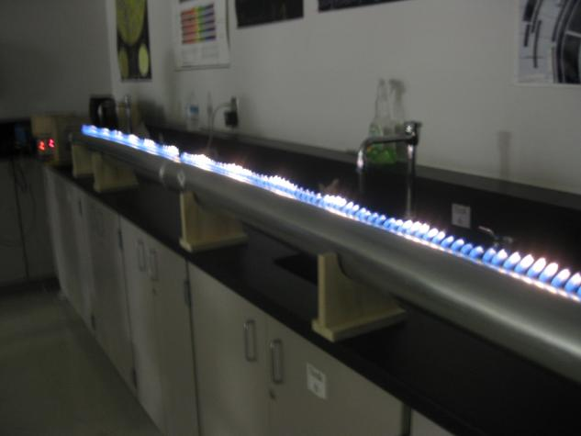
Let the fun begin

Slide 14
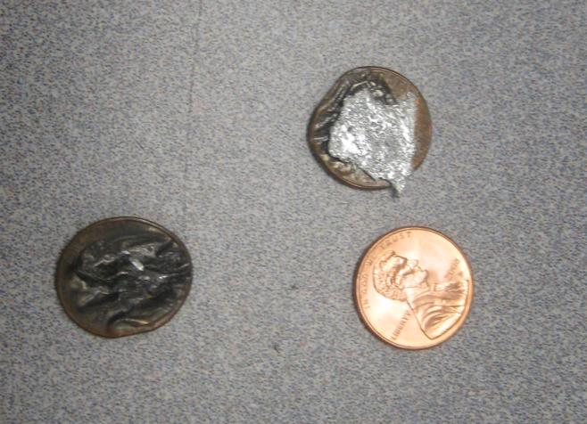
Solar Penny Melter

Slide 15
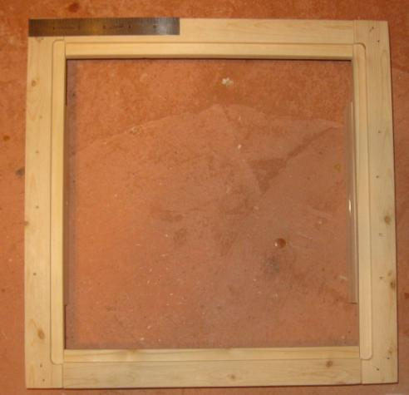
Lens Frame
14.5” x 14.5” – 1” x 2” lumber

Slide 16
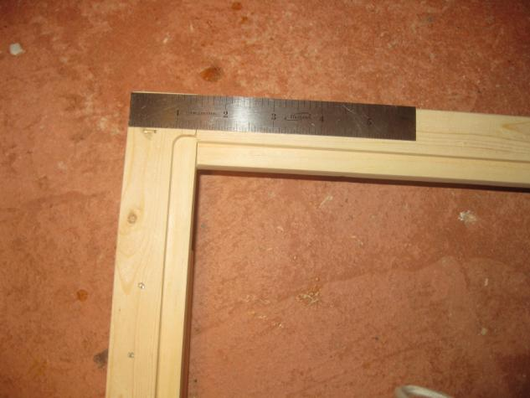
Router - ¼” deep x ½” wide

Slide 17
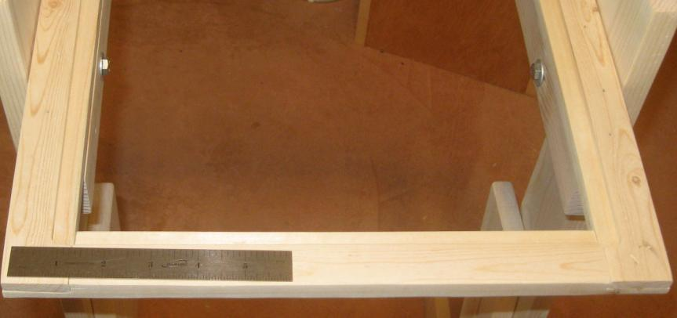
Lens Frame

Slide 18
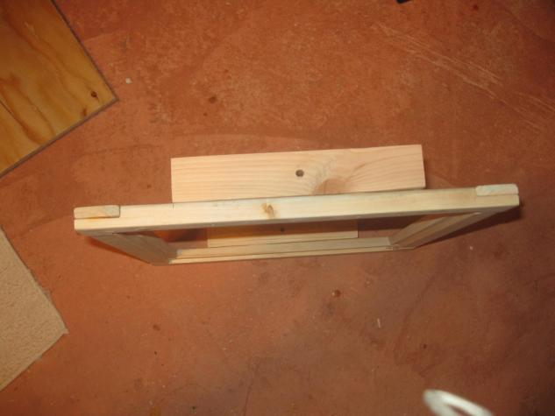
Lens Frame – 2” x 2” x 8” connection

Slide 19
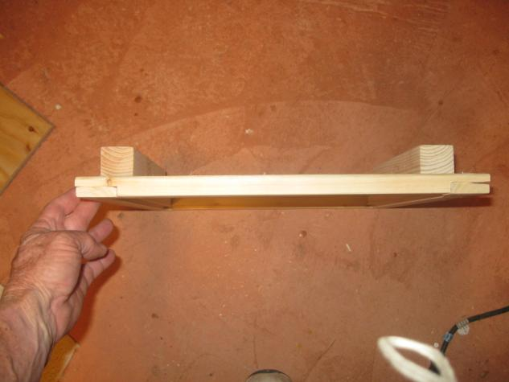
Lens Frame – side view

Slide 20
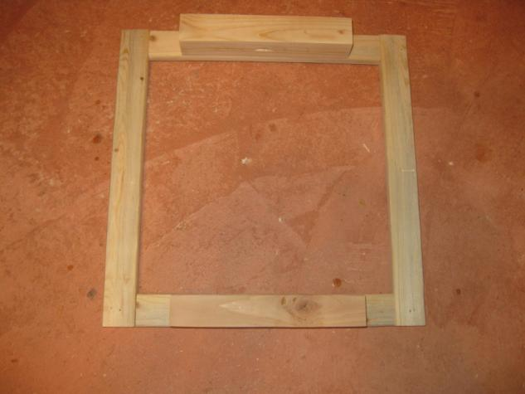
Lens Frame – bottom view

Slide 21
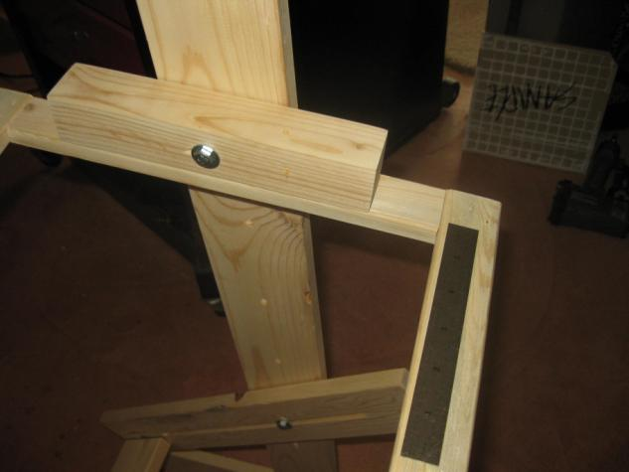
Lens Frame connection (upside down)

Slide 22
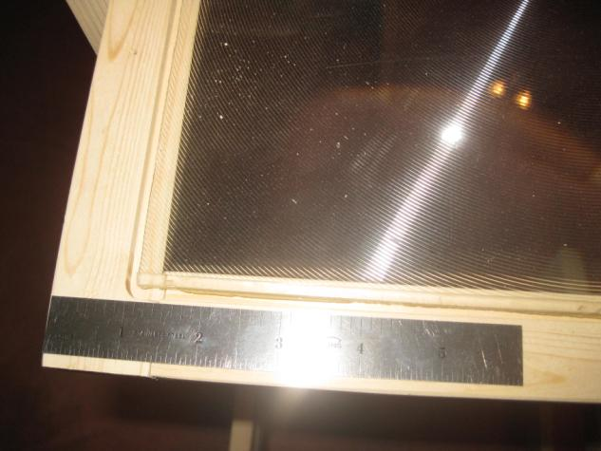
Lens Frame with Lens

Slide 23
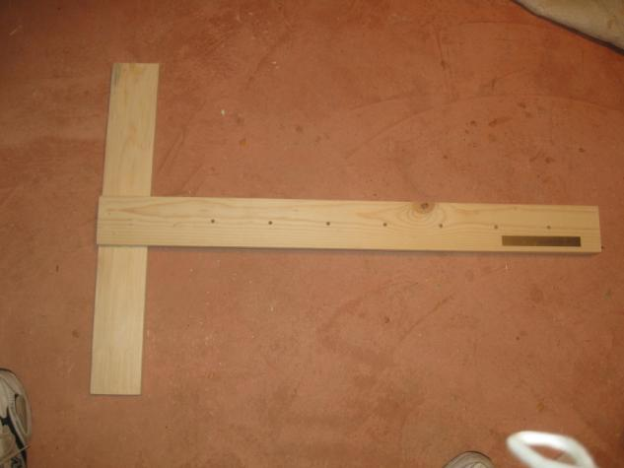
Legs – 1” x 4” x 36”. Drill holes every 4”

Slide 24
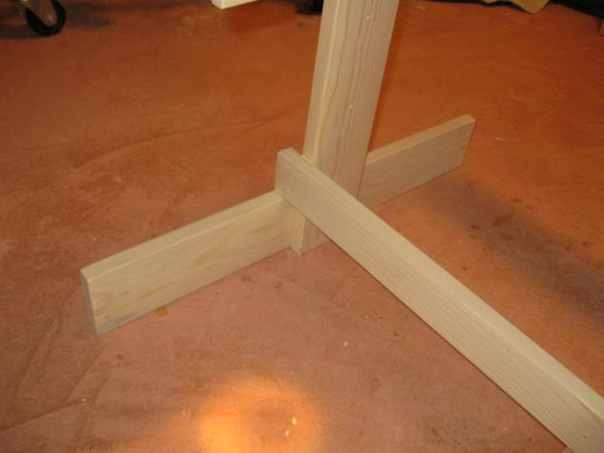
Legs with cross bracing

Slide 25
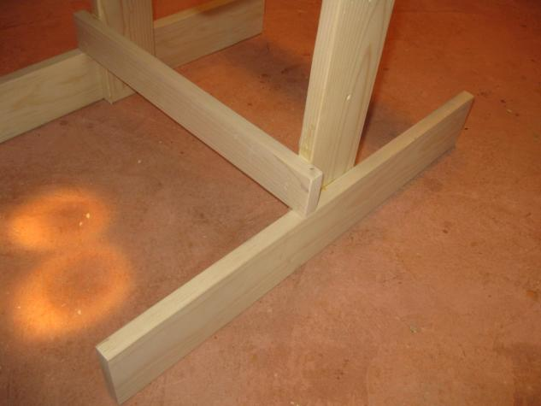
Legs with cross bracing

Slide 26
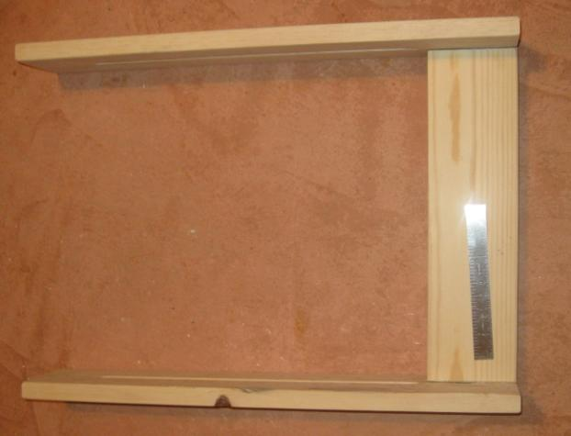
Support Platform

Slide 27
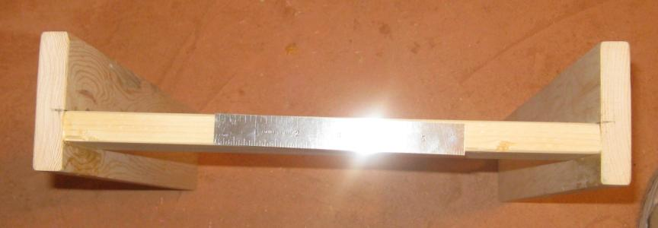
Support Platform – edge view

Slide 28
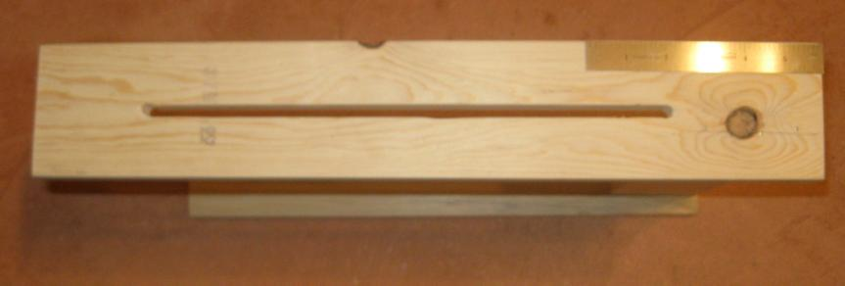
Support Platform – side view

Slide 29
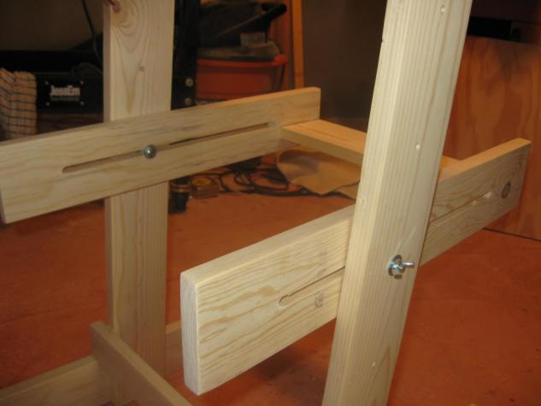
Support Platform – connection

Slide 30
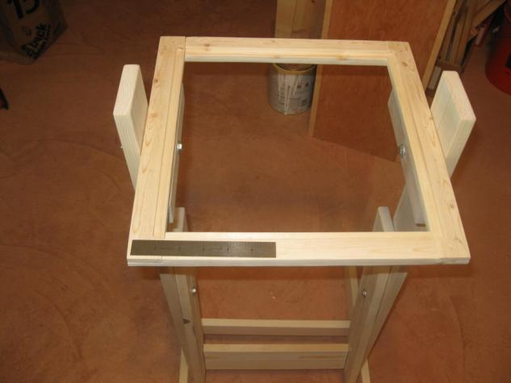
Top View

Slide 31
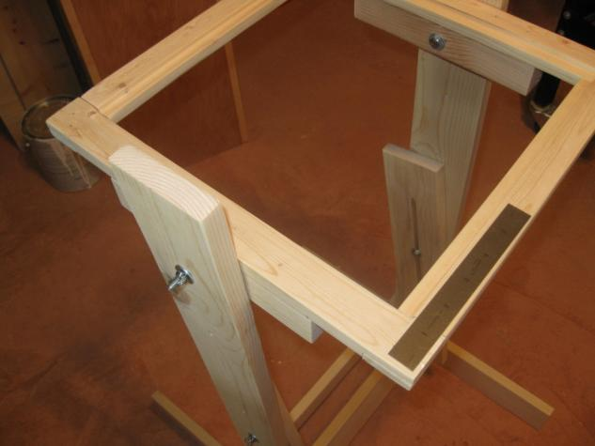
Connections

Slide 32
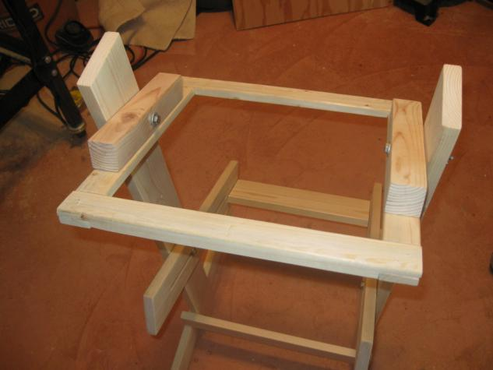
Lens frame inverted

Slide 33
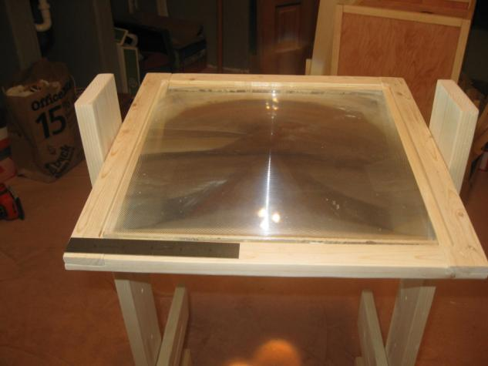
Frame with lens in

Slide 34
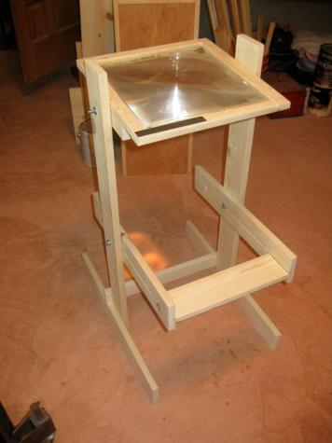
Assembled

Slide 35
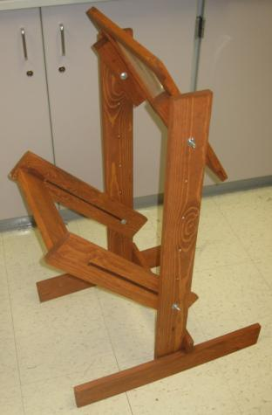
Finished Product

Slide 36
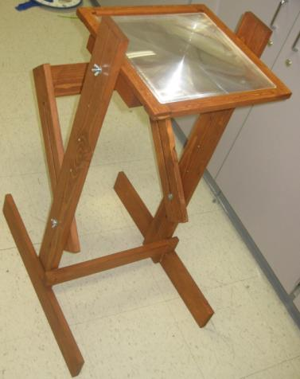
Finished Product

Slide 37
Credits
The Penny Melter was adapted from “Physics Demonstration Apparatus”, by Martin C. Sagendorf, Sanford House Press, 2009 - available from Educational Innovations
The Ruben's Tube was adapted from a personal communication from Alice LeVan, Kodiak High School, Alaska

Slide 38
Presenters Contact Information
Ann Hammersly - Chaparral H.S. ahammersly@susd.org
Tom Vining - Desert Mountain H.S. tvining@susd.org
Ryan Hill - Desert Mountain H.S. rhill@susd.org

